Slide 1
Capstone Project Presentation
Yu-Sheng Chen
12/16/2022

Slide 2
Objectives
Build a machine learning model that can be used to make distributional prediction of GHG emission intensity for companies.
Create an interactive graphical application so that users can approach the models and display the results easily.

Slide 3
Data Source
Stocks from both Bloomberg ESG index and Russell 3000 index are used.
After the data preprocessing, the amount of the instances is ~20,000.
As for the variables, companies’ fundamental metrics, including total asset, revenue, market cap, number of employees, bics level 4 field as well as the historical emission data are taken.

Slide 4
Data Preprocessing
The estimated GHG Scope 1 figure is used as proxy if companies don’t report GHG Scope 1 number.
To handle missing value, the data points with any missing value(s) are removed for three main reasons.
Clustering
Dramatic changes before and after the IPO
Increasing complexity of result analysis

Slide 5
Gaussian Process Regression (GPR)
Gaussian Process is a Bayesian, non-parametric and probabilistic machine learning algorithm.
A Gaussian process is a distribution over the function space.
A Gaussian Process is a collection of random variables such that the joint distribution of every finite subset of random variables is multivariate Gaussian.

Slide 6
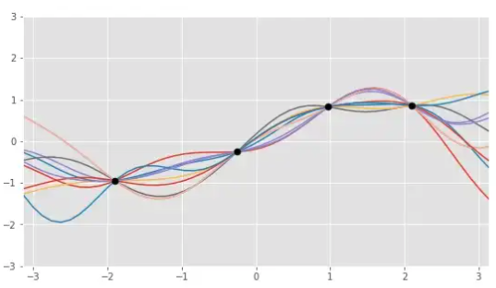
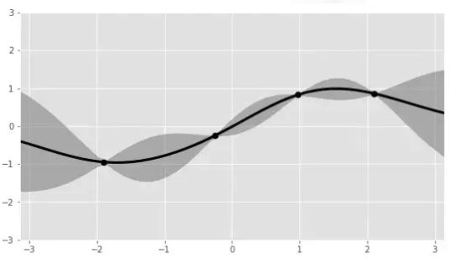
Gaussian Process Regression (GPR)
Some realizations of the GP
95% prediction interval from the GP

Slide 7
Gaussian Process Regression (GPR)
Advantage :
Both prediction and uncertainty estimates have analytical forms
Prior belief can be shaped via the choice of kernel
Disadvantage :
GPR is computationally intensive as it requires inverting the whole training dataset

Slide 8
Kernel
In GPR, kernel is also called covariance function.
Kernels are identical to the ones in Support Vector Machine.
The most widely used kernels include Linear Kernel, Periodic Kernel and Radial Basis Function Kernel.
Kernels can be combined through both multiplication and addition.

Slide 9
Model Structure
Log transform the label and numerical features
Make distributional prediction !
Separate models are trained for difference BICS Level 4 sector
Inverse log transform the output from the model

Slide 10
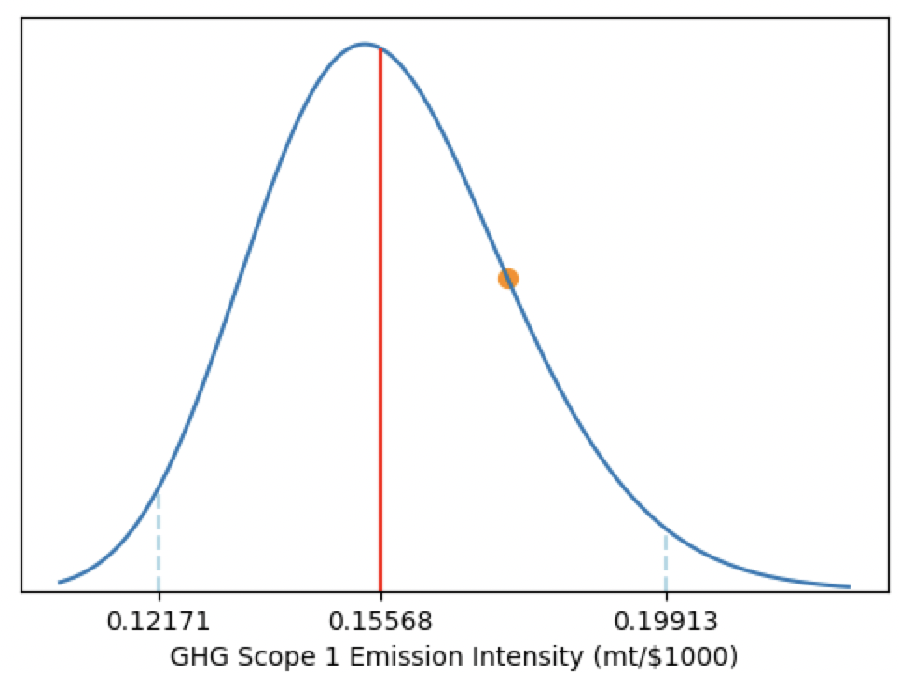
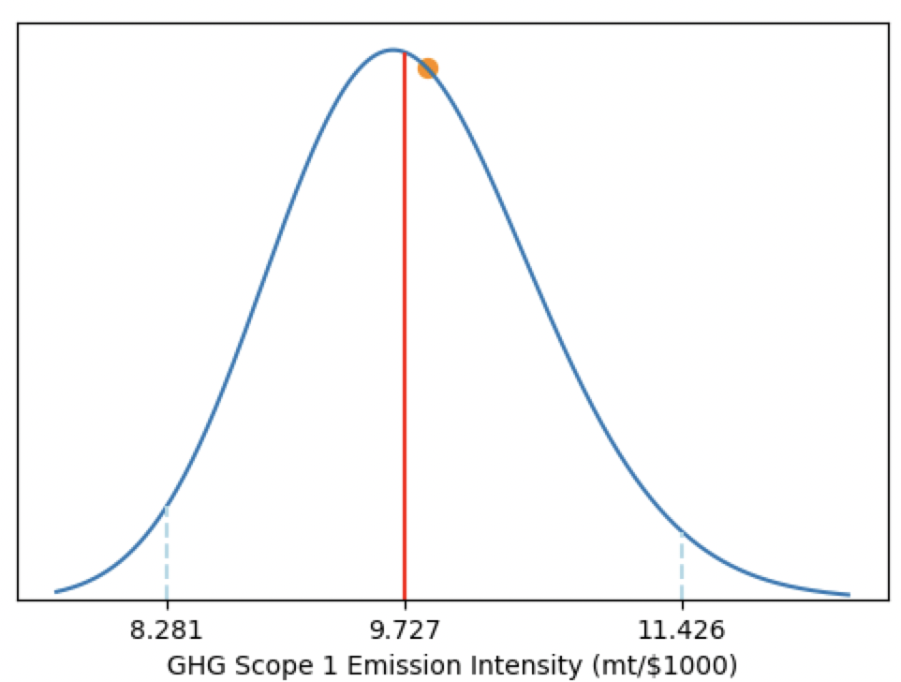
Sample Model Predictions
Prediction for Google in 2021
Prediction for General Motor in 2021

Slide 11
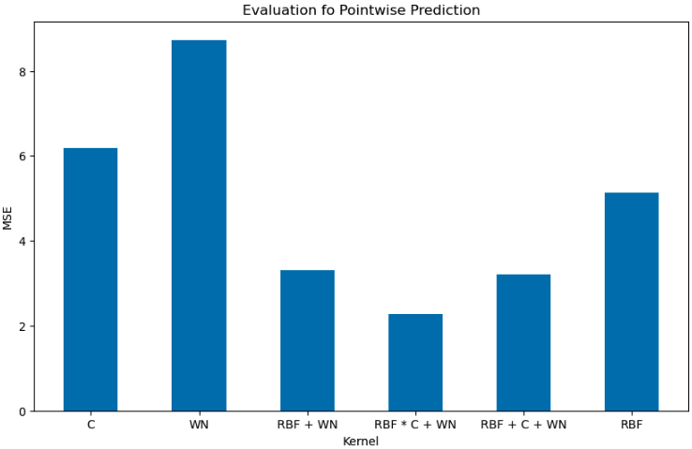
Model Evaluation
Mean squared error is used as the metric for evaluation of the model’s ability to produce point estimates.

Slide 12
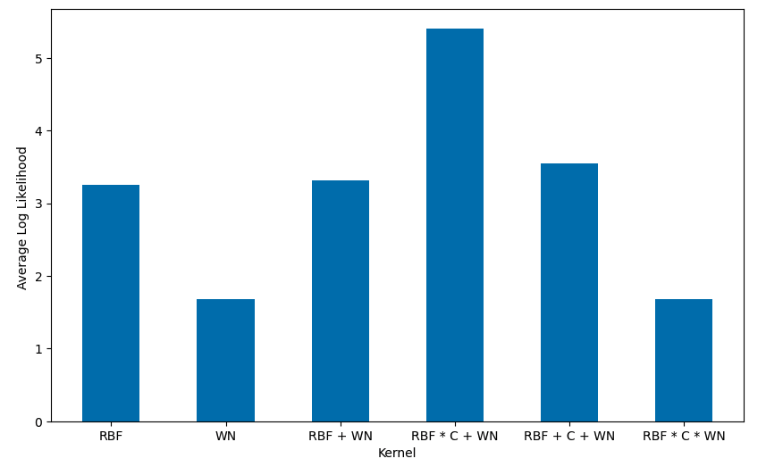
Model Evaluation
Log likelihood is used as the metric for evaluation of the model’s ability to produce interval estimates.

Slide 13
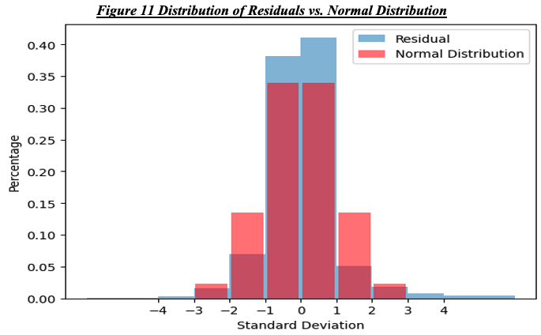
Model Evaluation
To test normality of the residuals, the histogram and QQ-Plot are looked at.

Slide 14
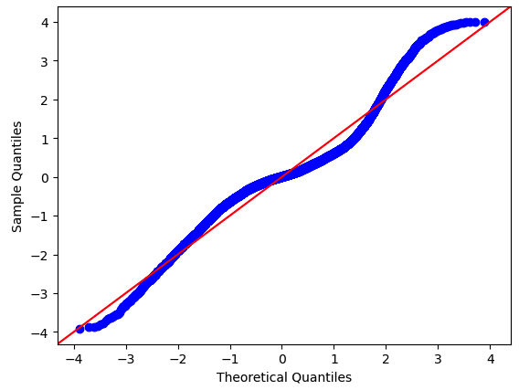
Model Evaluation
QQ-Plot of the residuals

Slide 15
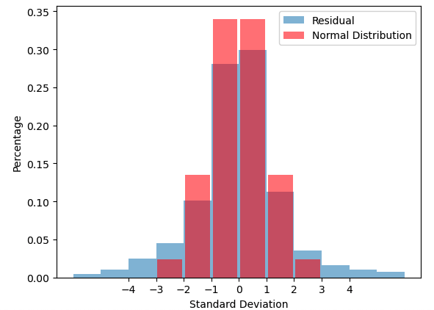
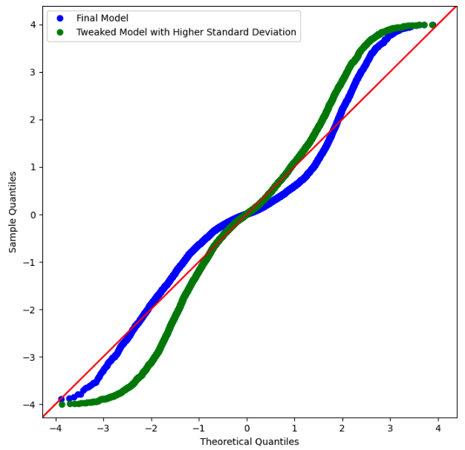
Model Evaluation
Lower the predicted standard deviations

Slide 16
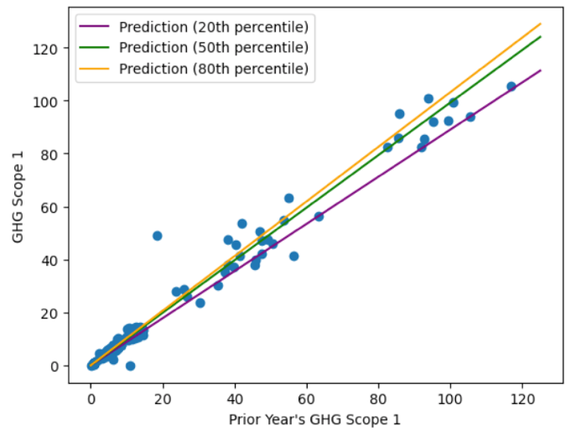
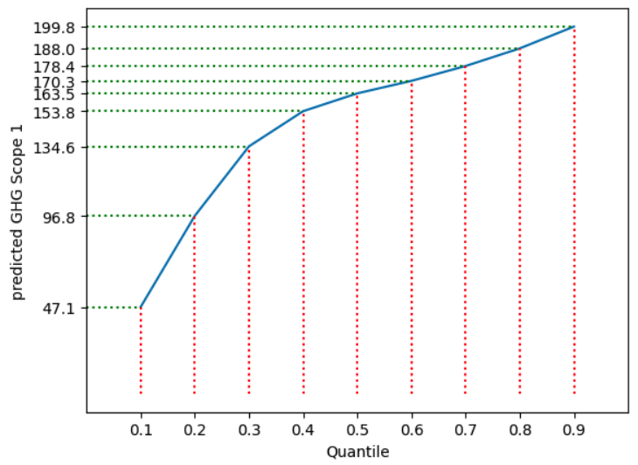
Quantile Regression (QR)

Slide 17
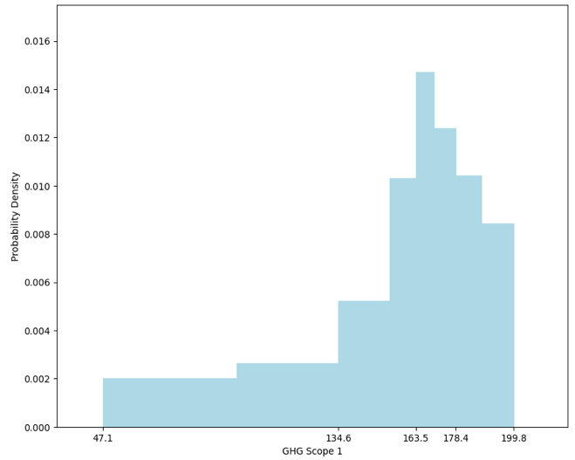
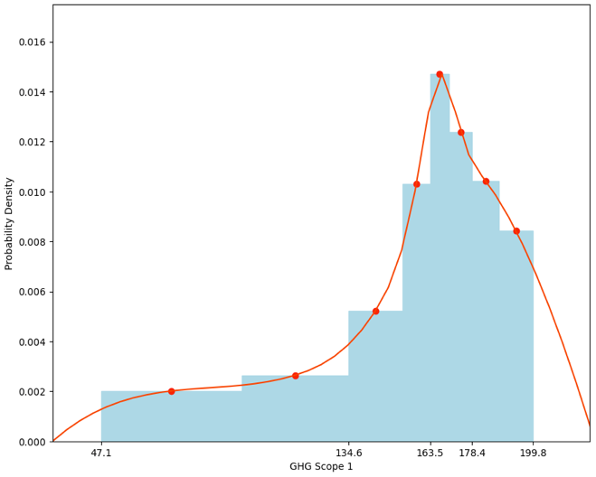
Quantile Regression (QR)

Slide 18
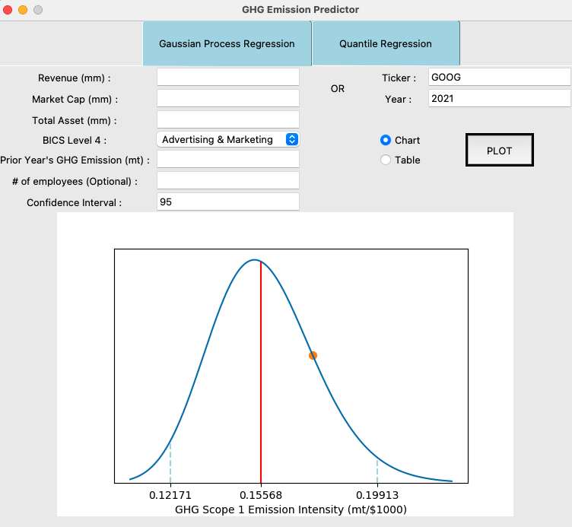
User Interface

Slide 19
Conclusion
GPR is a powerful, versatile and easily implemented algorithm to make distributional prediction.
The performance of the final GPR model is acceptable.
More data or more features don’t guarantee better performance for GPR as it may cause the model to more frequently chase outliers.

Slide 20
Further Improvements
Customized kernels
Student-t Process Regression
Time-series features

Slide 21
Thank you !

